Slide 1
Annual Members vs. Casual Riders Bike Usage
Presented By: Federico Llorden
Last Updated On: 28-Sep-2022

Slide 2
Agenda
Objective
Findings
Recommendations
Questions

Slide 3
Objective
Understand how annual members and casual riders use Cyclistic bikes differently, in order to determine the best marketing strategy to convert casual riders into annual members.
Notes:
The problem is how to convert casual riders into annual members.

Slide 4
Findings
Number of trips
By membership type
By type of bicycle
Top Performing trips
By Month
By Day of Week
By Hour
Top 30 trips
Casual members
Annual members
Trip duration
Average
Trips between 0-1 hs.
Trips between 1-2 hs.

Slide 5
Data Used
Source: Monthly data directly from the company’s website
Period covered: January 2021 to December 2021
Data anomalies were cleaned as far as possible
Notes:
Records that were excluded:
Start time greater than end time
Trip lengths (in minutes) less than or equal to 0
Start or End station names were null
Start or End station names like ‘Base Warehouse’
The station IDs were inconsistent. Not only was the data type changed from string to number but the IDs did not consistently match the station names. For these reasons, the station IDs were not used.
The ride IDs were not unique. Will need further clarification on this.
Will also need further clarification if trips can legitimately be less than or equal to one minute.

Slide 6
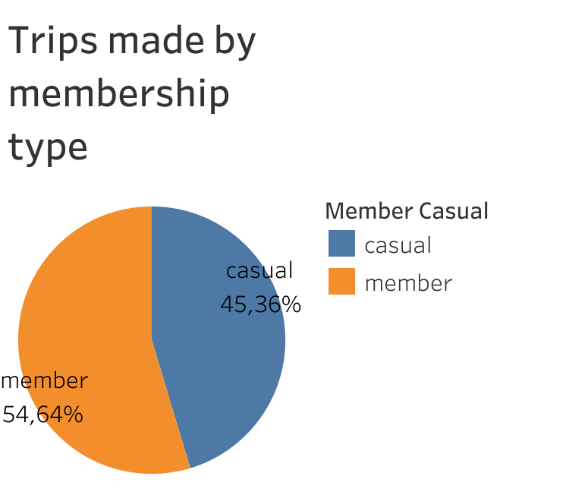
Number of trips:
By Membership type
Key takeaway
Annual Members make the most trips overall
Notes:
Number of trips shown as a percentage
Total trips are 4.056.911

Slide 7
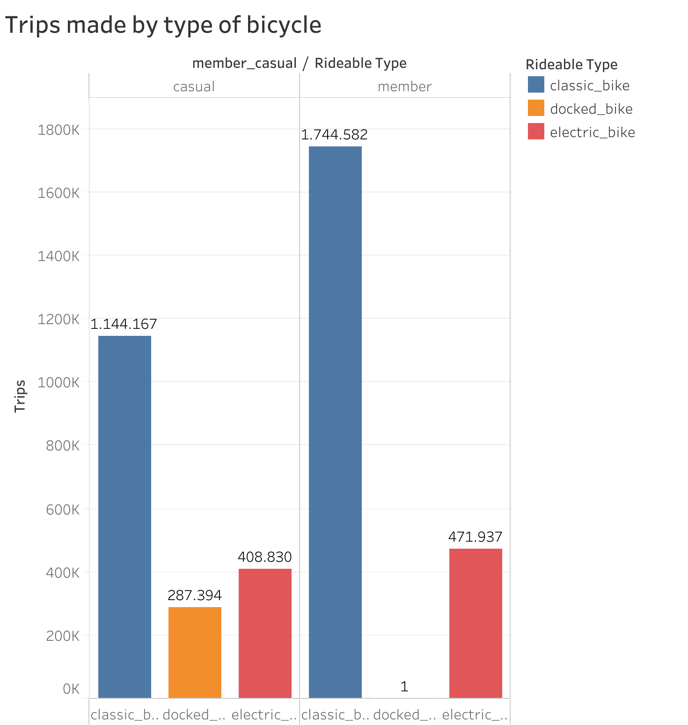
Number of trips:
By type of bicycle
Key takeaways
Both Annual Members and Casual Members prefer classic bikes, rather than other types of bike.
Annual Members made almost 600k more trips than Casual Members.

Slide 8
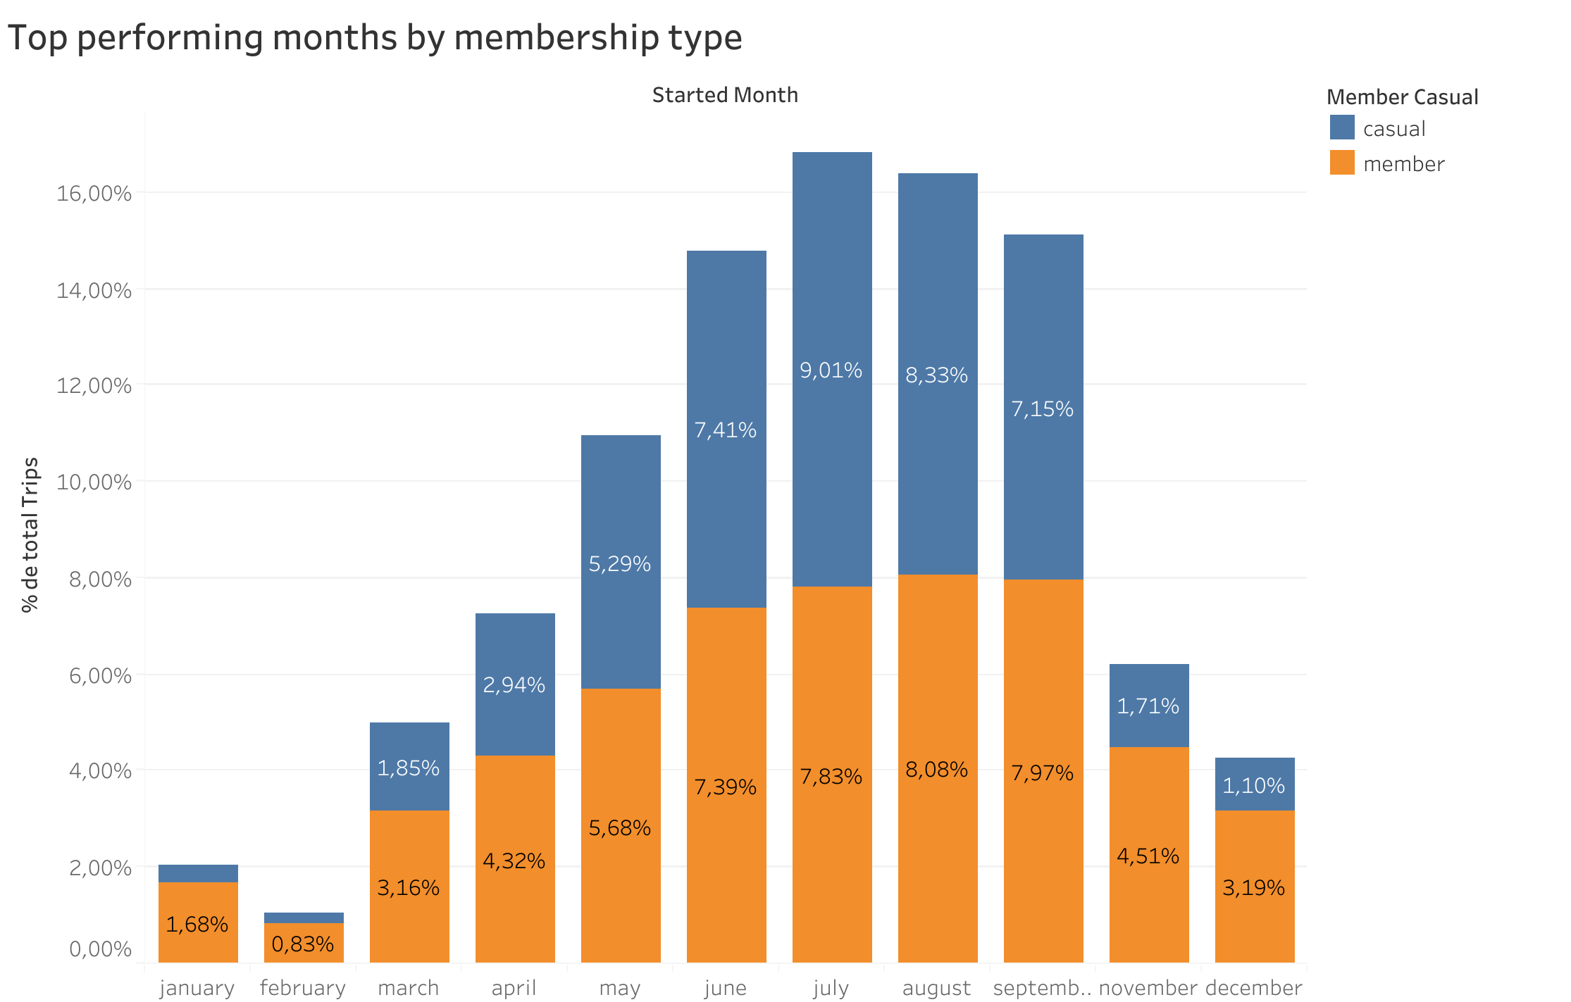
Top performing trips:
By Month
Key takeaways
Casual Members overtook the Annual Members from June 2021 to August 2021.
Warmer months bring more Casual Members than Annual Members.
Further analysis is needed to identify:
If this pattern is consistent with other years
Notes:
Used the trips’ Start Date to get the Month
Number of trips shown as a percentage

Slide 9
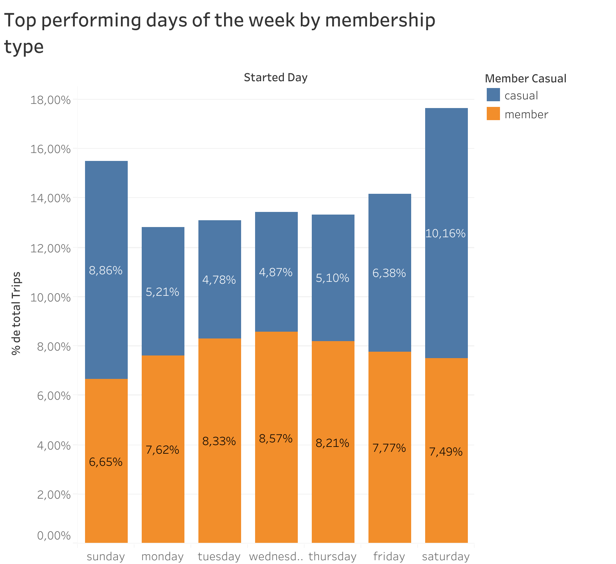
Top performing trips:
By Days of the Week
Key takeaways
Casual Members made most trips on Sundays and Saturdays.
Annual Members preferred day is Wednesday, although they’re consistent with the usage through the week.
Notes:
Used the trips’ Start Date to get the Week Day
Number of trips shown as a percentage

Slide 10
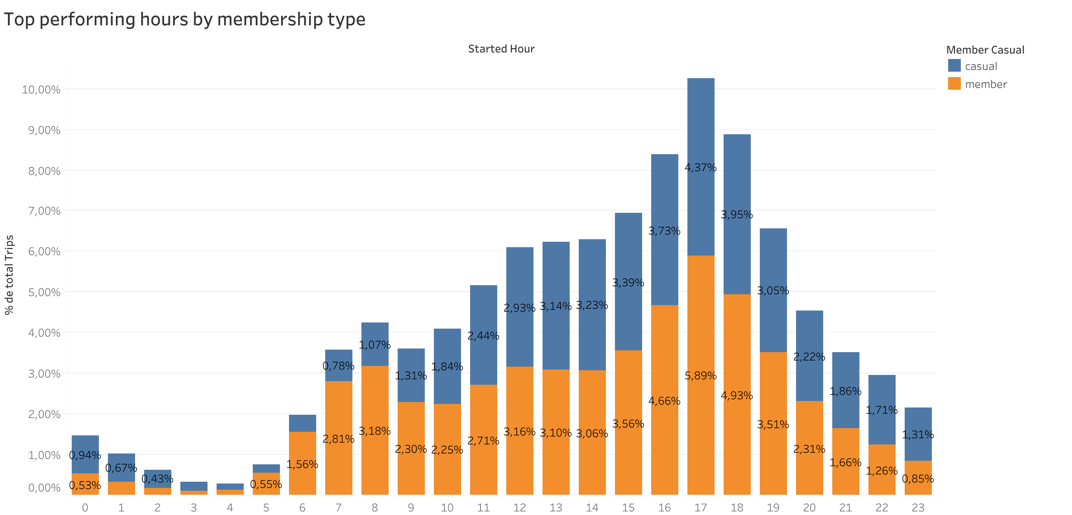
Top performing trips:
By Hour
Key takeaways
Annual Members use is related to commuting hours. It peaks at 7 and 8, and from 16 to 18 hs.
Casual Members usage performs better than Annual Members during nighttime.
The peak hour is at 17.
Notes:
Used the trips’ Start Date to get the Hour of Day
Number of trips shown as a percentage

Slide 11
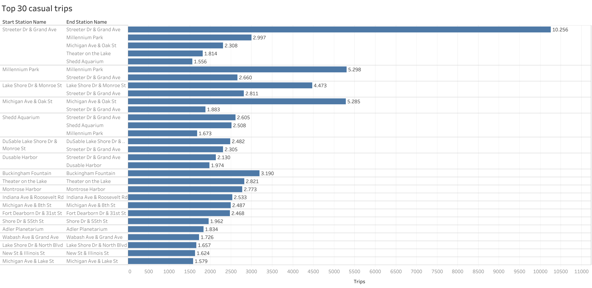
Top 30 casual trips:

Slide 12
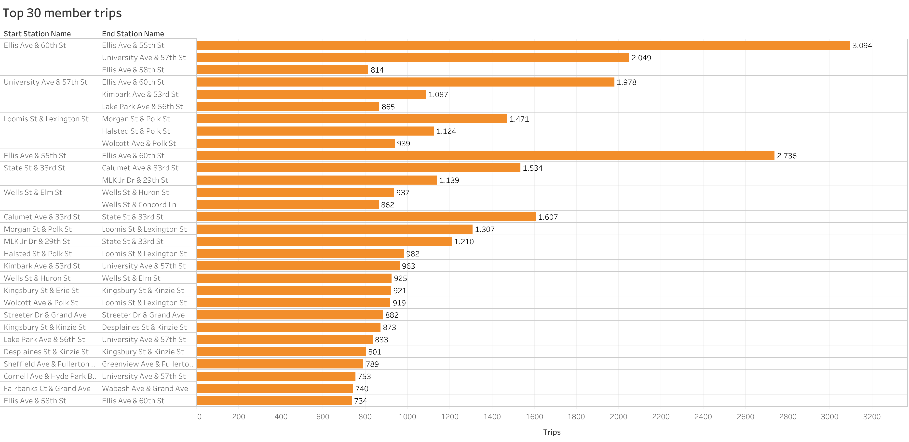
Top 30 annual member trips:

Slide 13
Top 30 trips:
Key takeaways
Casual Members prefer to start their trips from Streeter Dr & Grand Ave. 18931 trips started from there, way more than the 882 trips made by Annual Members.
Annual Members prefer to start their trips from Ellis Ave & 60th St. 5957 trips were made from over there.

Slide 14
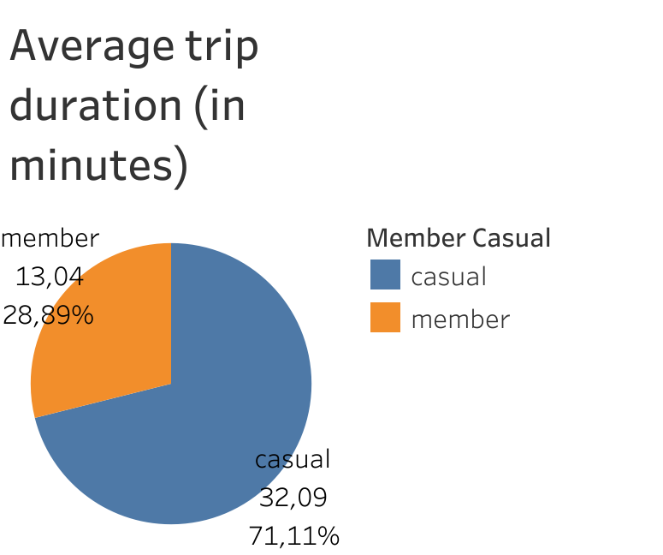
Trip duration:
Average
Key takeaways
Casual Members average bike use is more than double than the one of Annual Members (32 vs 13 minutes)
Casual Members make up almost 71% of the total trip duration.

Slide 15
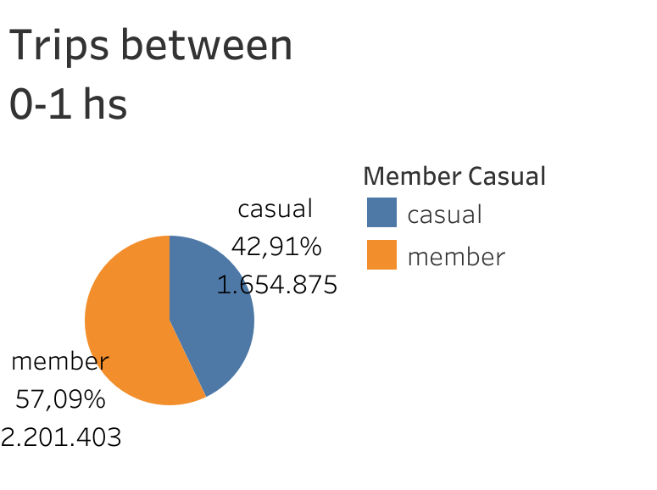
Trip duration:
Trips between 0-1 hs.
Key takeaways
Annual Members make up more than half of total trips between 0-1 hs.
Almost 95% of trips are made between 0-1 hs.
Notes:
95% is made up by 3.856.278 / 4.056.911 (total trips)

Slide 16
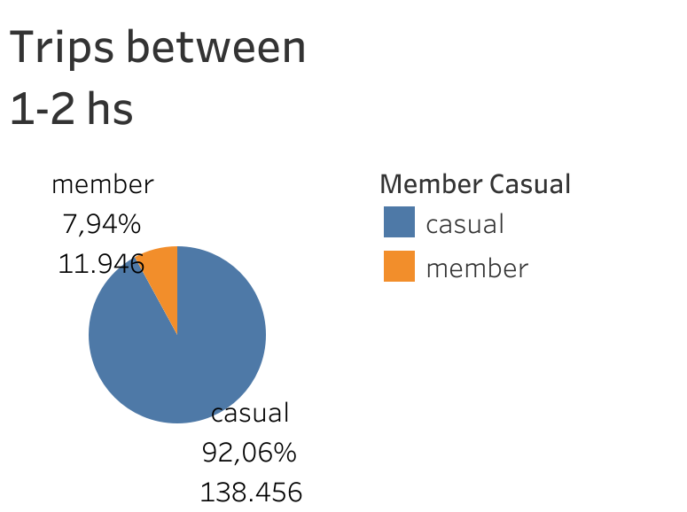
Trip duration:
Trips between 1-2 hs.
Key takeaways
After the first hour, Casual Members are the ones using bikes the most (almost 92%)
Trips between 1-2 hs make up almost 3.7% of total trips
Notes:
3.7% is made up by 150.402 / 4.056.911 (total trips)

Slide 17
Overall Takeaways
Casual Members mainly use the Streeter Dr & Grand Ave, Millennium Park and Lake Shore Dr & Monroe St stations (these areas should be targeted specifically)
While most Casual Members make trips that last less than 1 hour, they make up the majority of trips longer than 1 hour (could be prioritized in a campaign for long trips)
The data suggests that Casual Members use bikes mainly on the weekend, while Annual Members tend to use it for commuting.
Both Annual Members and Casual Members prefer classic bikes over the rest of bikes.
Warmer months bring more Casual Members than Annual Members (summer campaign)

Slide 18
Next Steps
Clarify anomalies in the existing data
Trips lengths (in minutes) less than or equal to 0
Start or End station names that were null or “Base Warehouse”
Inconsistent station IDs
Duplicated ride IDs
Gather more data for further analysis
Compare data with previous years
Check if trends stay the same as the results that were gathered
Check if data-privacy issues can be solved in order to identify better our customers
Make surveys to gather more relevant information regarding bike usage

Slide 19
Thank You!

